Slide 1
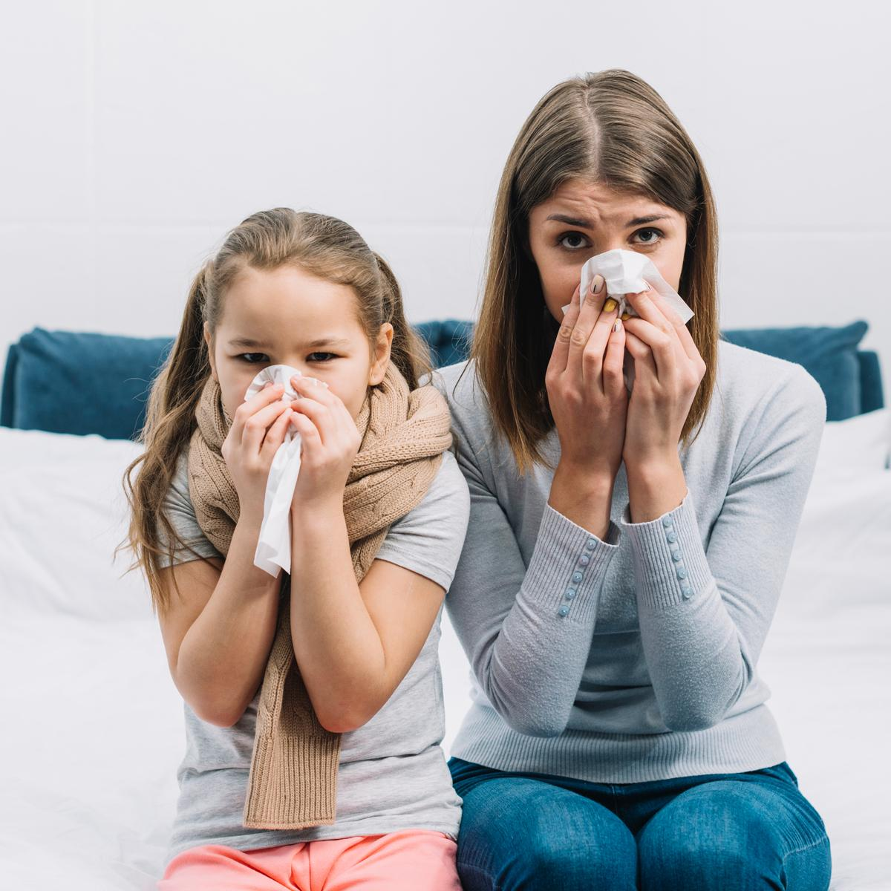
QUARANTINE MANAGEMENT SYSTEM

Slide 2
OVERVIEW
The COVID-19 pandemic has highlighted the critical importance of efficient Quarantine Management Systems in curbing the spread of infectious diseases.
The primary goal of the project is to help people through the unfortunate virus outbreak.
The website provide information about the quarantine centers in each district and the users will be able to search location by district and choose available centers.
Its implementation can significantly contribute to minimizing the spread of contagious diseases and maintaining the well-being of individuals under quarantine.

Slide 3
01 02 03 04 05 06 07
USER REGISTRATION AND AUTHENTICATION
USER CAN VIEW HOUSES ON HOME PAGE
SEARCH FUNCTIONALITY
HOUSE BOOKING
DOCUMENT UPLOAD AND VERIFICATION
OWNER APPROVE OR REJECT USER BOOKING
OWNER ADD HOUSES

Slide 4
FEATURES AND HIGHLIGHTS
There are 3 users in the system admin, owner, user.
User can search a house based on location and capacity.
During booking user can select check in and check out date.
Admin approves or reject the owner based on the documents they upload during registration.
Users can upload documents while booking
Owner verifies the documents upload by user and approve or reject bookings.
Owner can add stay homes details.
The owner will be able to login to the system if the admin approves him/her.

Slide 5
THIRD PARTY LIBRARIES
Django-jazzmin: a drop-in app to jazz up your Django admin site, with plenty of things you can easily customize, including a built-in UI customizer.
Pillow: Pillow library is for image processing tasks such as opening, manipulating, and saving images.

Slide 6
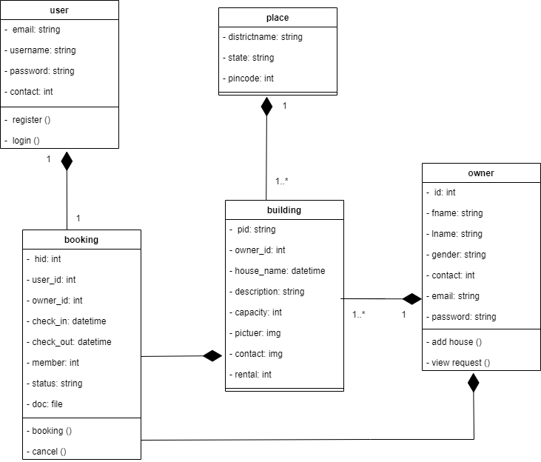
CLASS DIAGRAM

Slide 7
CHALLENGES FACED
I felt its difficult to set the validation for a home stay date for a particular house taken by one person can’t be taken by another one.
When it comes to the validation area i found difficulties in validating check in and check out fields.
The documents uploaded by the owner during registration should be approved by the admin. Implementing this condition into my project was difficult

Slide 8
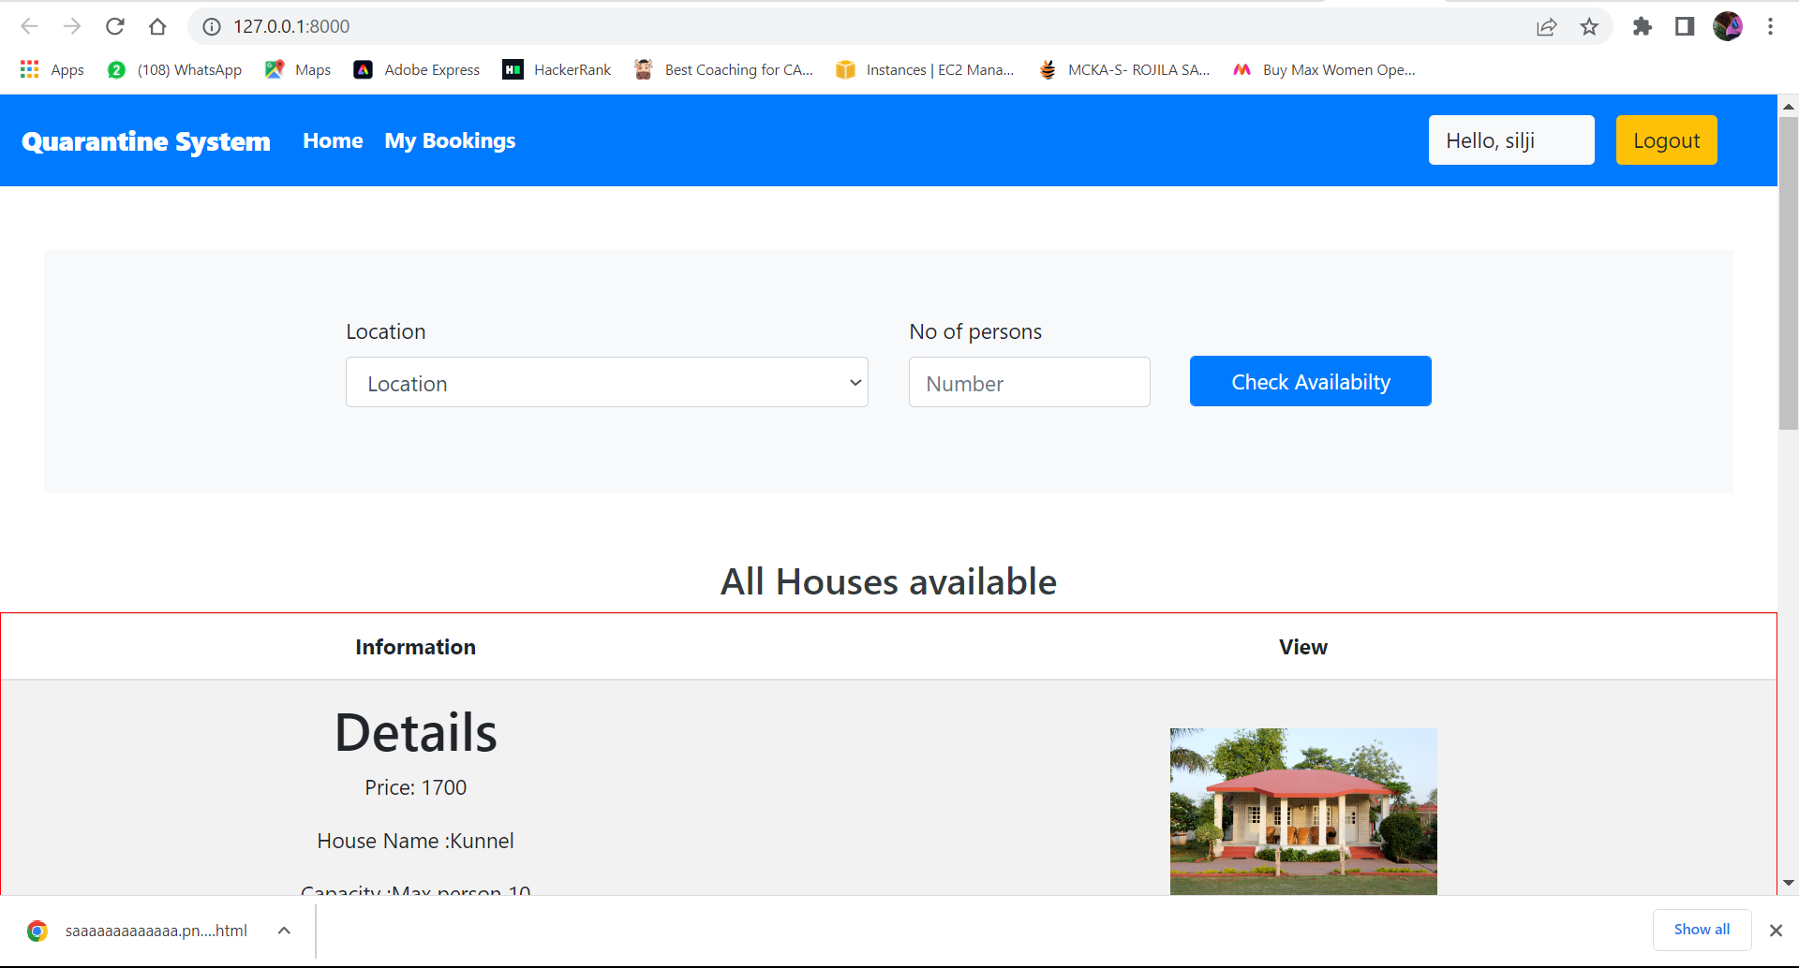
SCREENSHOTS

Slide 9
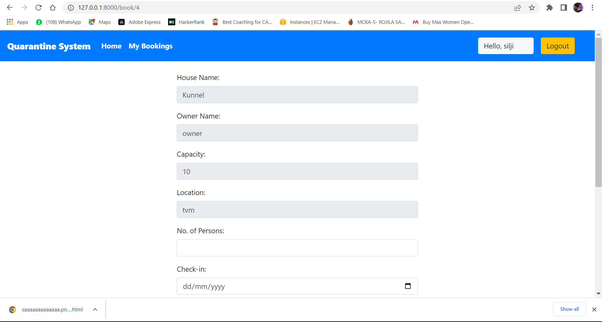

Slide 10
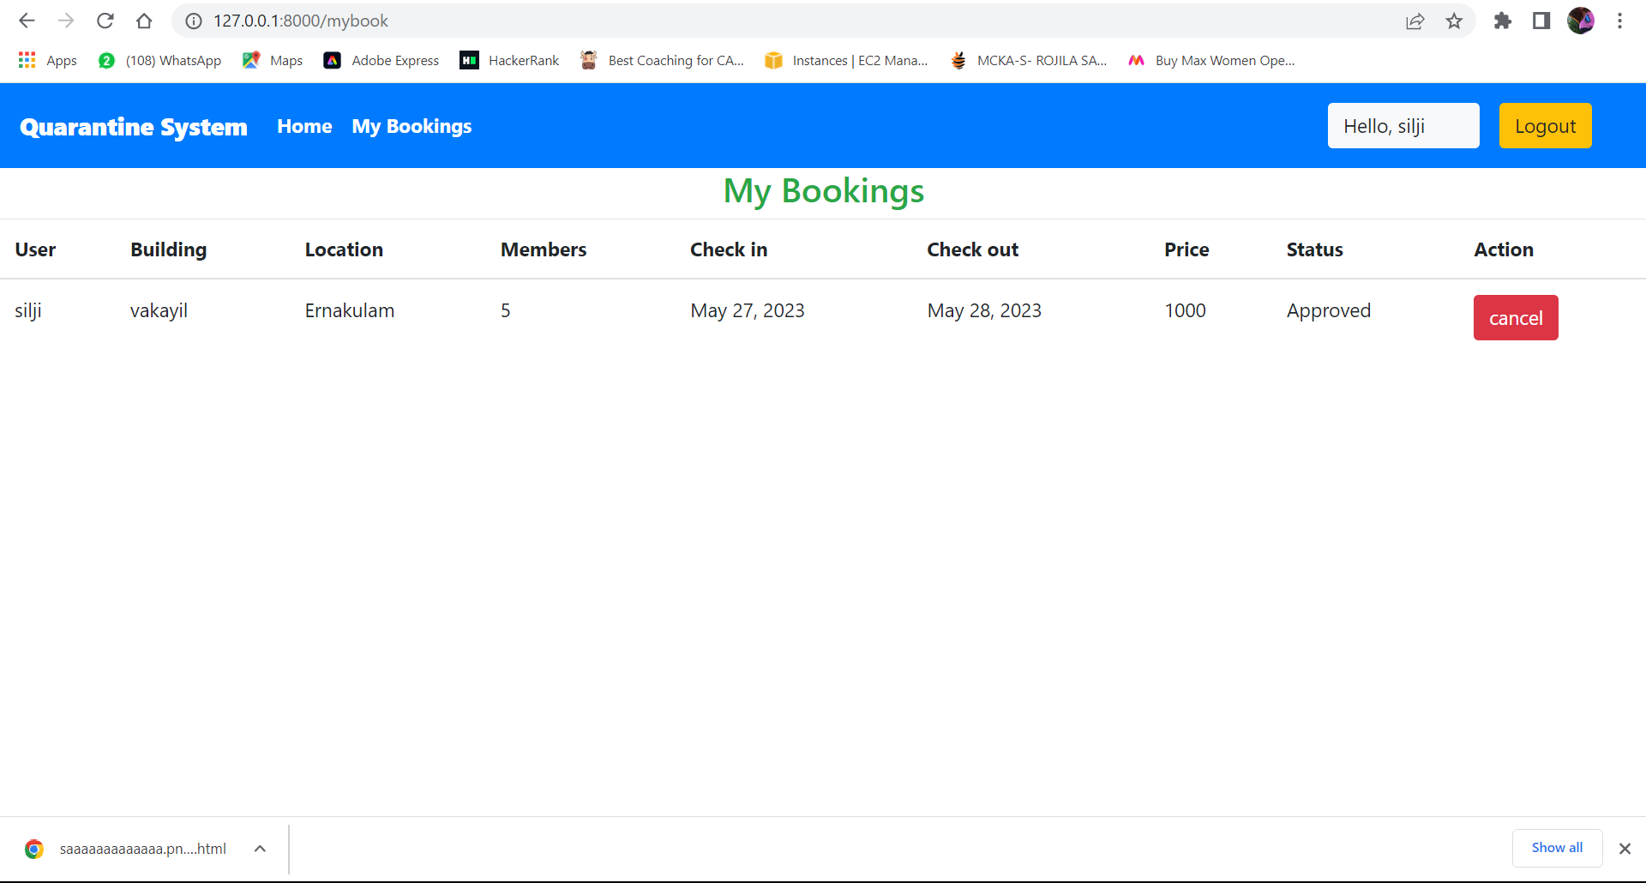

Slide 11
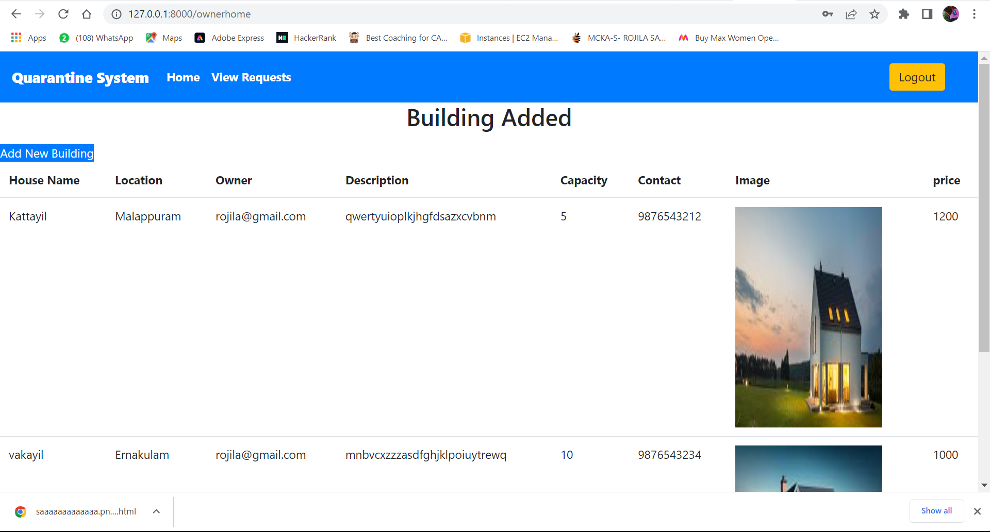

Slide 12
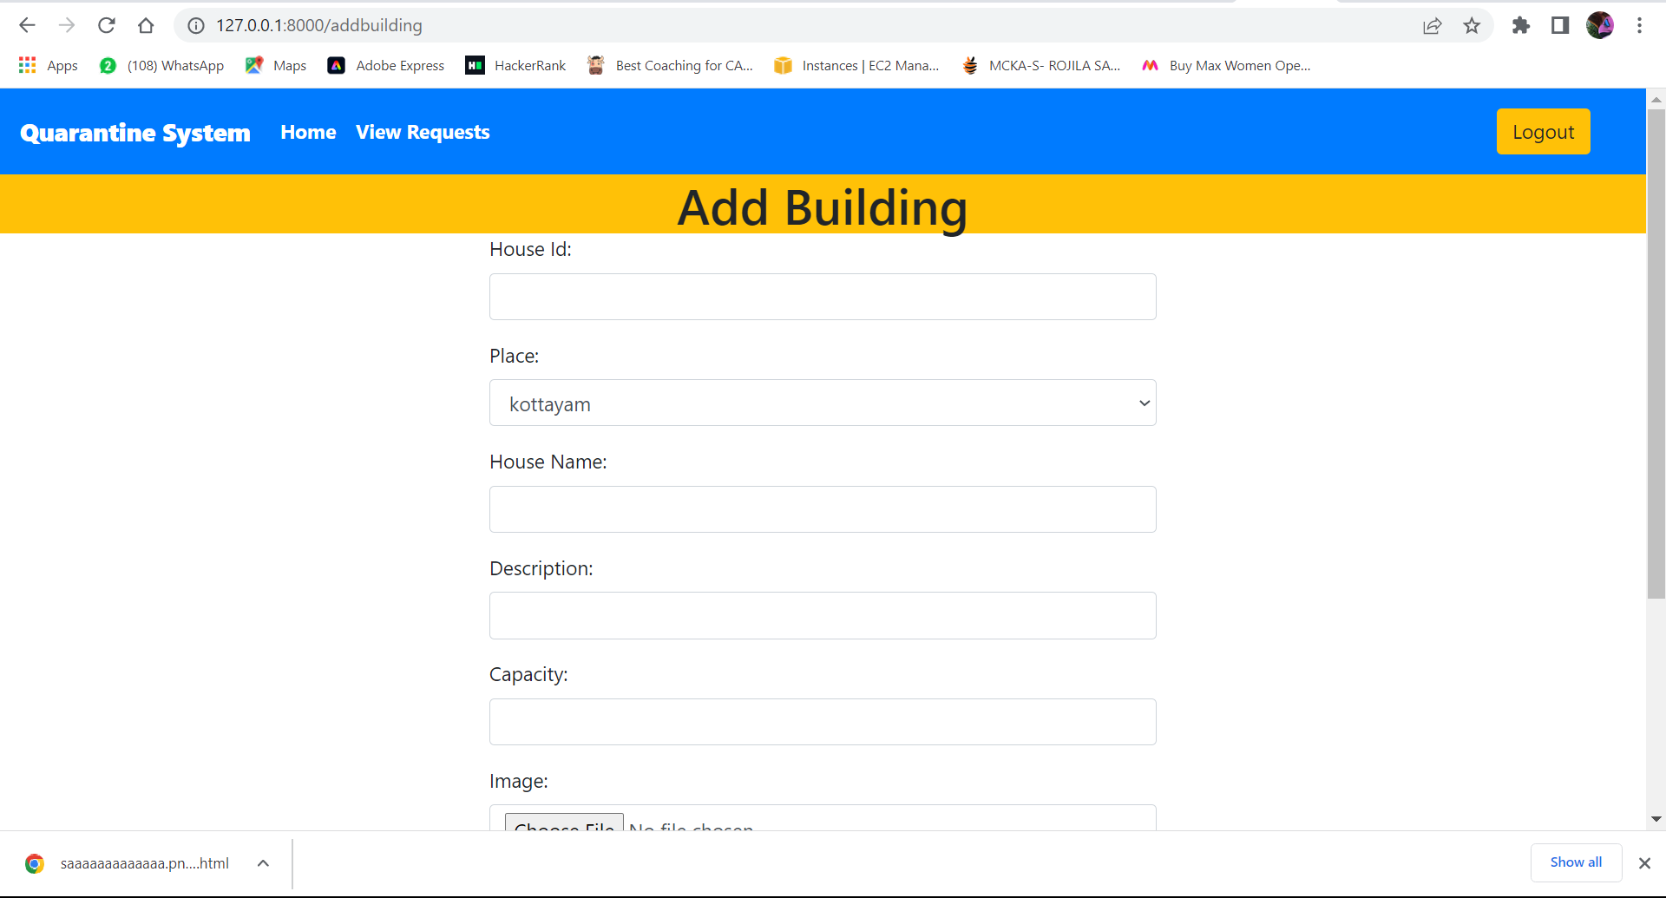

Slide 13
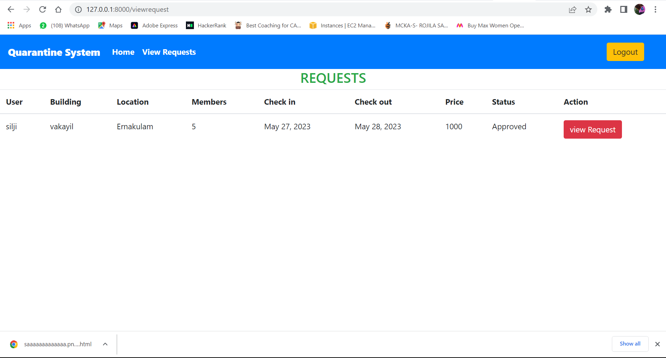

Slide 14

FUTURE ENHANCEMENT
Payment option.
Chat option between users and owner
Daily updates of covid positive.

Slide 15
CONCLUSION
In conclusion, a quarantine home management system is a vital tool for efficiently and effectively managing individuals isolation and quarantine periods.
The system provides an easy medium for citizens to access its features.
The purpose is to design a system which reduces the burden of having to visit people and house for rent.

Slide 16
REFERENCES
https://www.mohfw.gov.in
https://www.fabhotels.com/hotels-with-quarantine-facility
https://www.travelguru.com/hotels/quarantine-self-isolation-hotels-in-cochin

